Slide 1
Online Examination System

Slide 2
Diagram Purpose
This BPMN provides a clear visualization of how the online examination process flows between users and system components. It helps in understanding, optimizing, and automating the examination lifecycle.

Slide 3
Online Examination System – BPMN Diagram Description
The BPMN (Business Process Model and Notation) diagram for the Online Examination System illustrates the flow of activities between three main participants: Student, System, and Instructor/Admin. This visual representation provides clarity on the sequence of operations required to conduct an online exam, from creation to result delivery.

Slide 4
Main Components and Their Interactions
Student initiates the process by logging into the system, viewing available exams, and starting an exam. They submit their answers and receive results automatically.
System handles critical backend functions such as login authentication, exam interface display, recording and storing answers, auto-grading, and result distribution.
Instructor/Admin creates exams, schedules them, and later reviews results and system reports to evaluate student performance.
These components interact through message and sequence flows that ensure a secure, responsive, and automated exam-taking experience.

Slide 5
Importance for Organizational Efficiency
Implementing this process contributes significantly to organizational goals by:
Reducing manual tasks like paper-based exams and grading.
Increasing accessibility by allowing students to participate from any location.
Enhancing scalability by accommodating a large number of students and exams without performance issues.
Ensuring security through controlled access and automated grading integrity.

Slide 6
Support for MIS Functions
The system supports Management Information System (MIS) functions by:
Improving decision-making: Results and performance analytics give instructors and administrators real-time data to identify trends and intervene where necessary.
Streamlining operations: Automation of exam delivery, grading, and feedback reduces human workload and minimizes errors.
Providing transparency: Digital records of student performance and time-stamped submissions support audit and verification.

Slide 7
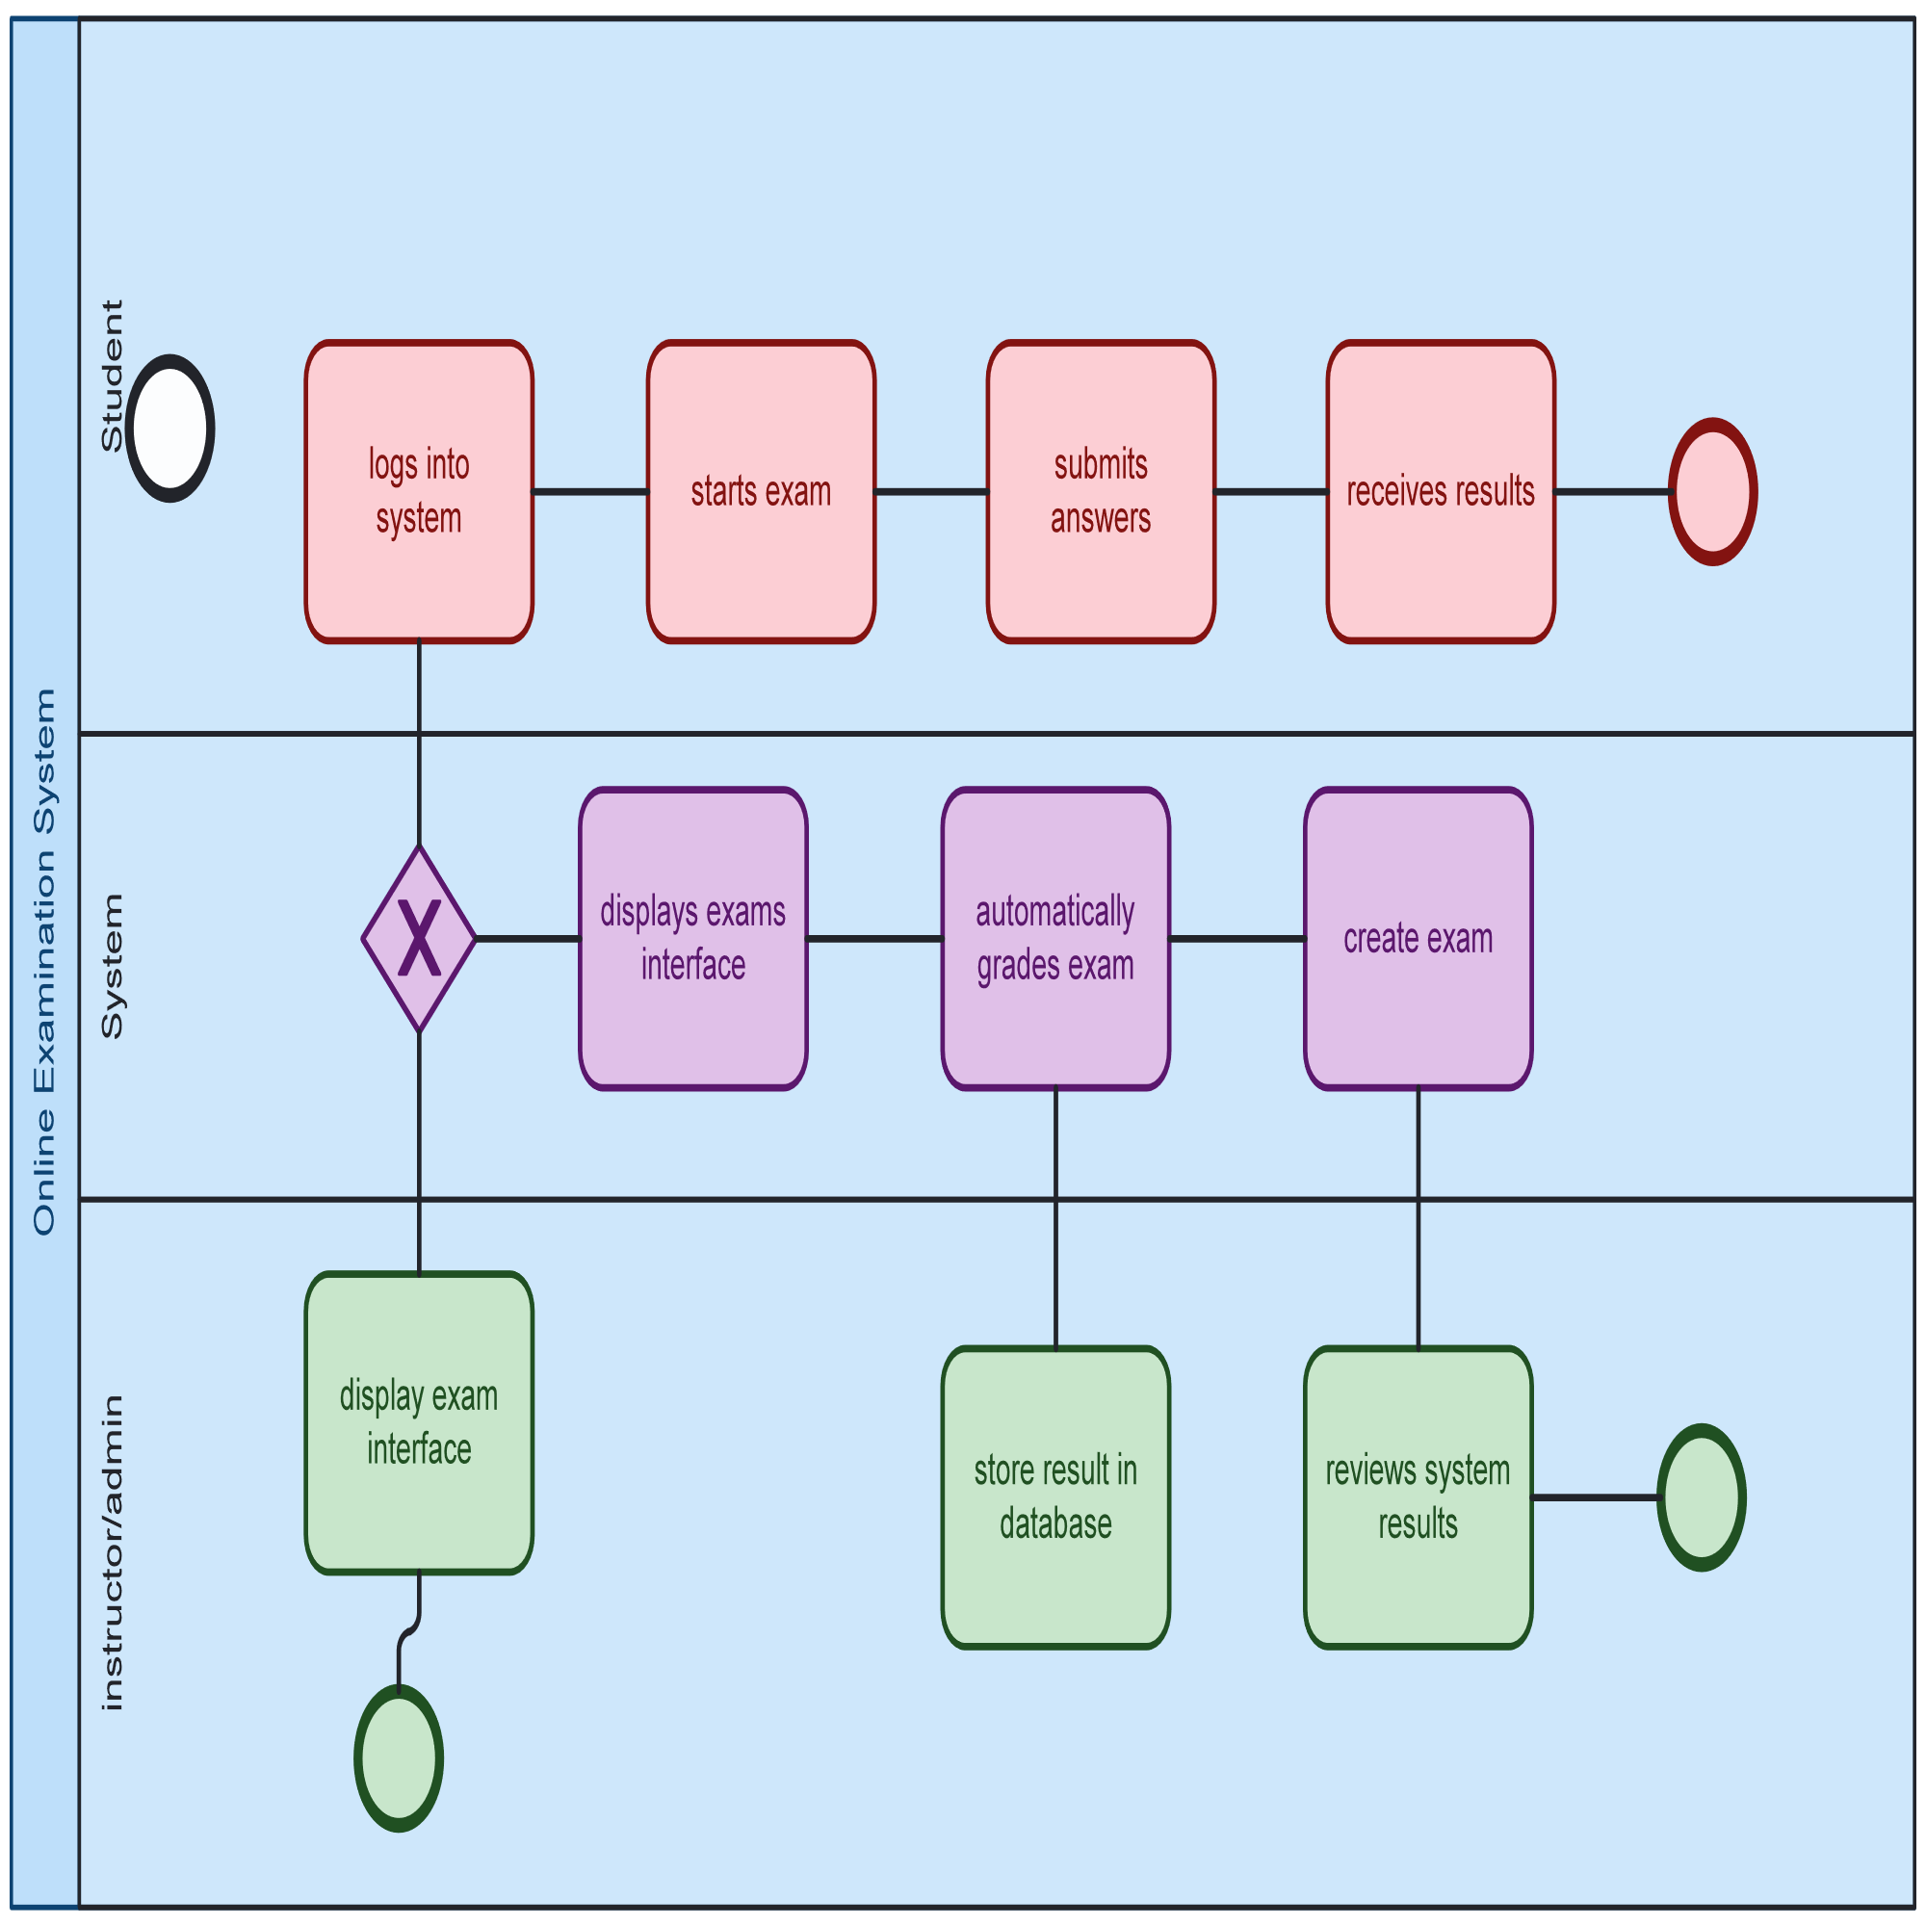
Online Examination System

Slide 8
1. POOLS AND LANES
Pools represent major participants. In this diagram, we have:
Student
System
Instructor/Admin
Each pool contains lanes to separate specific tasks or roles.

Slide 9
2. Student Lane
Login to System: Student logs into the exam platform.
View Available Exams: Browses exams.
Start Exam: Selects and begins the exam.
Answer Questions: Completes the exam.
Submit Exam: Sends answers for grading.
Receive Results: Gets graded outcome.

Slide 10
3. System Lane
Authenticate User: Verifies login credentials.
Display Exam Interface: Loads exam UI.
Record Answers: Saves responses in real time.
Auto-grade Exam: System grades the exam.
Store Results in DB: Saves final scores.
Send Results to Student: Notifies student of their results.

Slide 11
4. Instructor/Admin Lane
Create Exam: Prepares questions and format.
Set Exam Schedule: Assigns date and time.
Monitor Exam (optional): May involve proctoring.
Performance: Reviews student performance.
Provide Feedback: Sends feedback or adjusts exams.

Slide 12
5. Connectors and Events
Sequence Flows: Arrows showing process order.
Message Flows: Dashed lines indicating communication.
Start Event: Triggered when a student logs in.
End Event: Happens after results are delivered.
Gateway (if used): Decision points (e.g., login success).

